Slide 1
Career Research
By: Hannah Speight

Slide 2
Research Process
The first thing we did is we went on to naviance and took a personality type survey.
With the results of the personality type survey I got a list of jobs to look through that matched my personality types.

Slide 3
Research Process
Out of that personality type survey I got I picked jobs and put 8 of the jobs I picked into a table.
After I put them in the chart I did further research about those 8 jobs in the chart.

Slide 4
Research Process
Once I filled out the chart for my 8 jobs, I made three charts the titles were projected job growth over the next 10 years, median or average annual salary per career, or educational level needed.
With these three charts I made three graphs to show my data.

Slide 5
Careers
New accounts clerk- I liked this job because of dealing with financial.
Teller- I like this job because you would be keeping money records.
Special education teacher preschool- I like this job because I would be helping children.
Childcare worker- I like this job because I would be working with kids and helping them learn.

Slide 6
Careers
Veterinarian- I like this job because I would get to work with animals and help them.
Animal trainer- I like this job because I would get to train and work with animals.
Cashier- I like this job because it is only one more year of school after high school.
Photographer- I like this job because it is taking photos and editing the photos to make them better.

Slide 7
Top Three Careers
I have narrowed my career choices down to three. The first one is a childcare worker. The second one is a photographer. And my third is an animal trainer. I like the childcare worker because it involves working with children. I like the photographer because it involves taking photos and editing the photos to make them better. I like the animal trainer because u get to train and work with animals which I like.

Slide 8
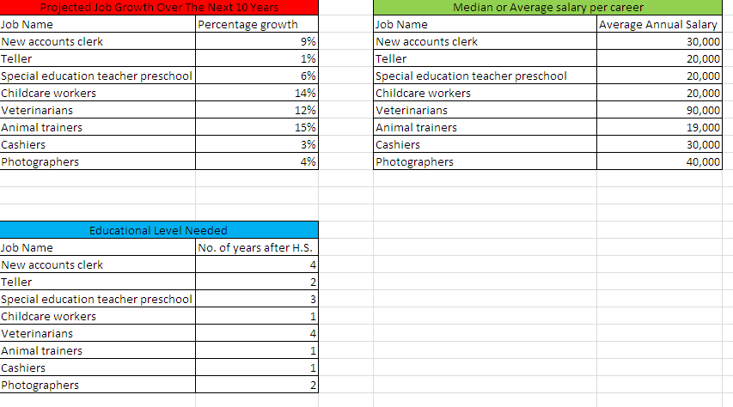
Charts

Slide 9
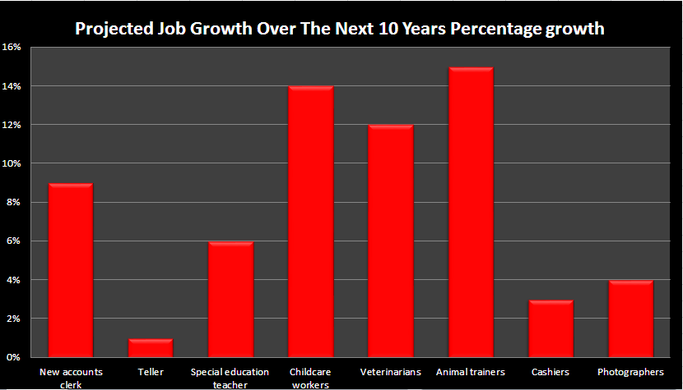
Graphs

Slide 10
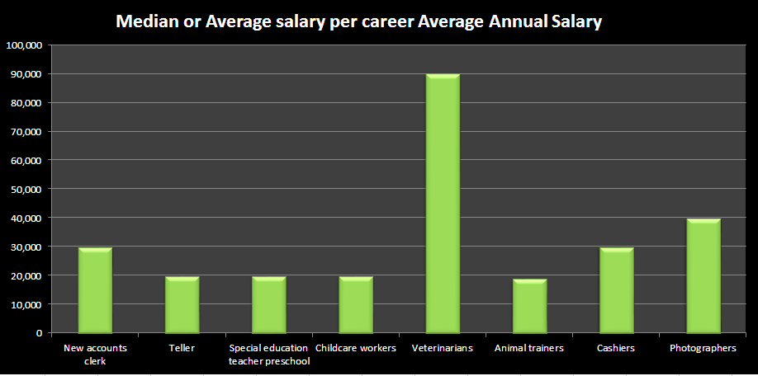
Graphs

Slide 11
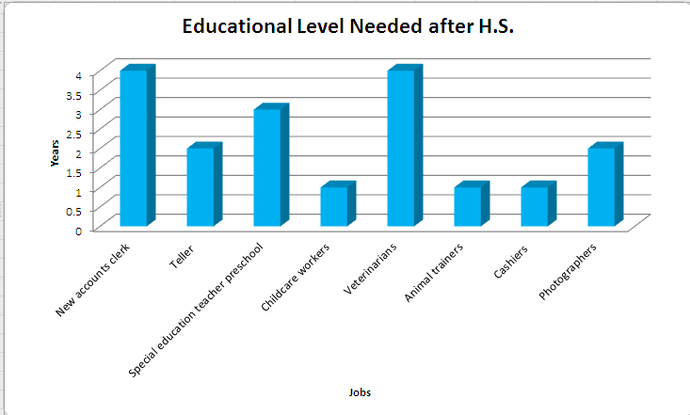
Graphs

Slide 12
Conclusion
I think that if I had to narrow it down to two jobs I would choose a childcare worker or photographer.
I think that I would do childcare when I have to pick one job.

